Slide 1


Bank Loan Analytics
View in Power BI

Slide 2
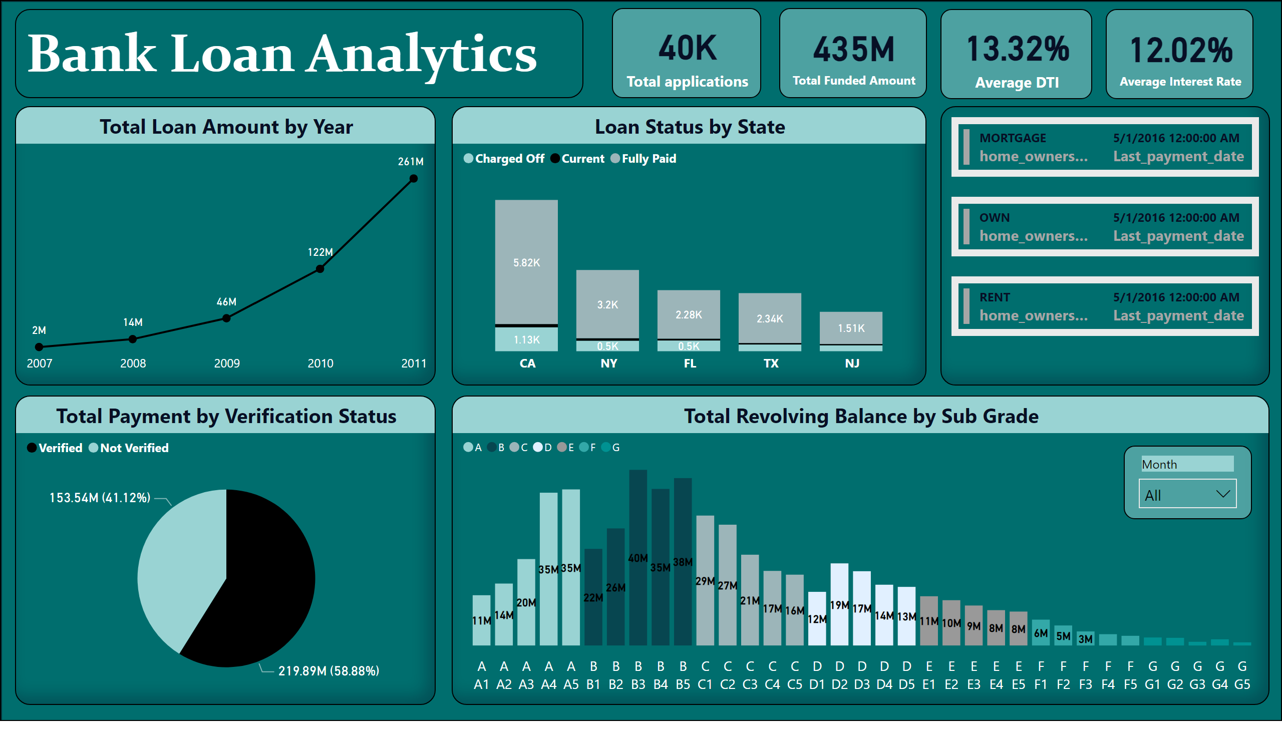
Dashboard
Notes:
shape
No alt text provided
Total Payment by Verification Status
No alt text provided
Total Revolving Balance by Sub Grade
No alt text provided
Total Loan Amount by Year
No alt text provided
multiRowCard
No alt text provided
Loan Status by State
No alt text provided
textbox
No alt text provided
slicer
No alt text provided
card
No alt text provided
card
No alt text provided
card
No alt text provided
card
No alt text provided

Slide 3
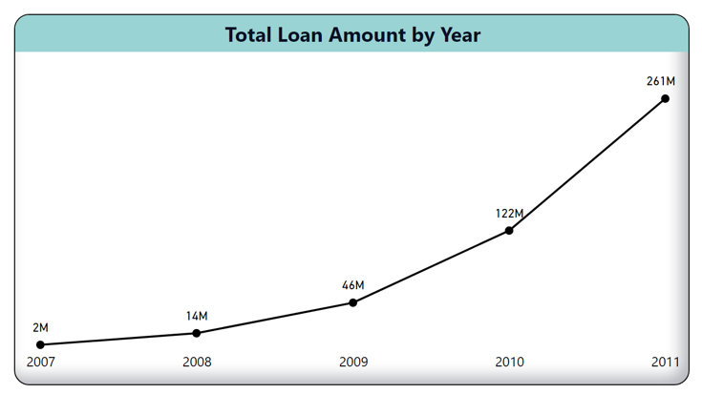
Yearly Loan Amount Analysis (2007-2011) Unveiling Trends and Opportunities

Slide 4
1. Observations:
Significant Growth: The graph indicates a substantial increase in the sum of Loan Amount over the years, with a remarkable 11,638.36% rise from 2007 to 2011.
Consistent Uptrend: The trend reveals a consistent upward trajectory, suggesting sustained growth in loan amounts over the specified period.
Steep Incline: The steepest incline occurred between 2007 and 2011, during which the sum of Loan Amount jumped from 2219275 to 260506575.
2. Suggestions:
Evaluate Economic Factors: Investigate the economic conditions during this period to understand if macroeconomic factors contributed to increased borrowing and investment.
Assess Market Demand: Conduct a thorough assessment of market demand for loans during the specified years. Identify key drivers that led to heightened borrowing activities.
Review Lending Strategies: Evaluate the lending strategies implemented during this period to determine their effectiveness in attracting borrowers.

Slide 5
3. Conclusions:
Strategic Success: The significant increase in the sum of Loan Amount indicates a successful implementation of lending strategies or the identification of opportunities that led to heightened loan demand.
Market Responsiveness: The steepest incline between 2007 and 2011 suggests a period of heightened responsiveness to market conditions or innovative product offerings.
Portfolio Expansion: The consistent uptrend across the specified years implies a proactive approach in expanding the loan portfolio, capturing a larger market share.
Additional Considerations:
Risk Management: Assess the risk management practices in place during the growth period to ensure that the increased loan amounts align with acceptable risk levels.
Customer Segmentation: Explore whether the growth is consistent across different customer segments or if specific segments are driving the increase.
Competitive Analysis: Conduct a competitive analysis to understand how the institution's loan offerings compared with competitors and whether there were unique selling propositions contributing to the growth.

Slide 6
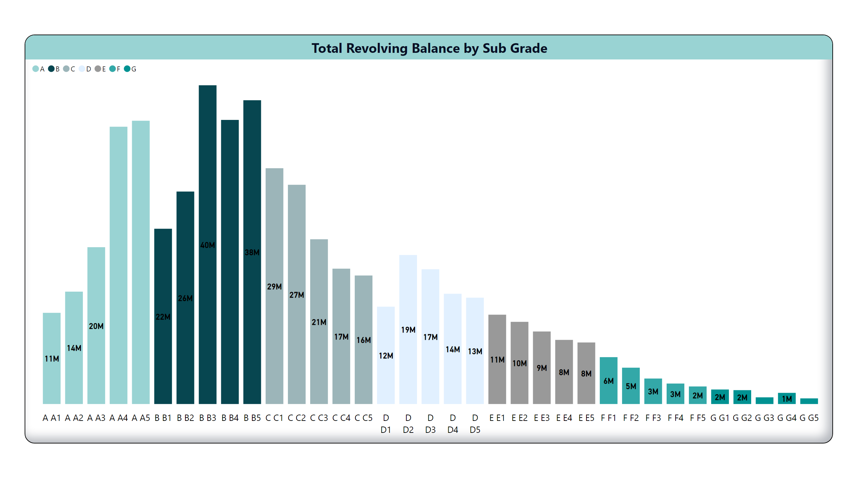
Grade/Sub Grade
Total Revolving Balance by Grade and Sub-Grade
Unveiling Distribution Patterns
Notes:
Total Revolving Balance by Sub Grade
No alt text provided

Slide 7
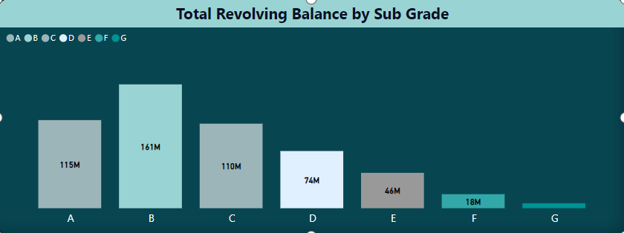

Slide 8
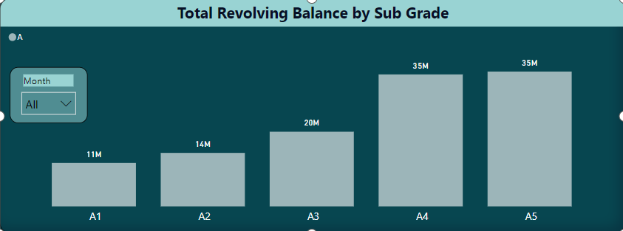
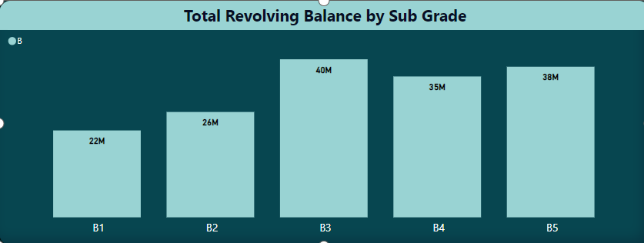

Slide 9
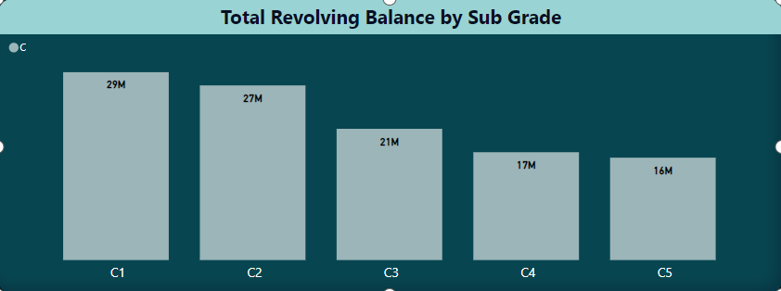
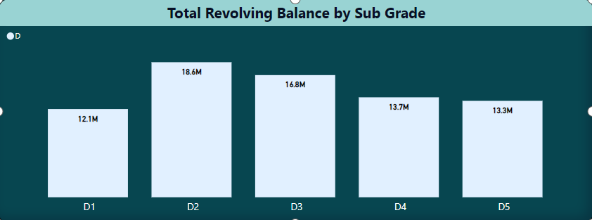

Slide 10
1. Observation: Grade B3 Contribution of 7.47% to Total Revolving Balance
Grade and Sub-Grade Distribution: The distribution of total revolving balance varies across different grades and sub-grades, with each contributing differently to the overall sum of revolving balance.
Concentration in Grade B3: Sub-grade B3, within Grade B, stands out with a significant share, comprising 7.47% of the total sum of revolving balance.
2. Suggestions:
Risk Analysis: Conduct a detailed risk analysis for Grade B3 to understand the factors contributing to its higher share in the total revolving balance. Evaluate whether this concentration poses any specific risks to the portfolio.
Diversification Strategies: Explore strategies to diversify the portfolio, especially in Grade B, to mitigate risks associated with a concentration in specific sub-grades.
Customer Engagement: Engage with borrowers in Grade B3 to understand their borrowing behavior and financial habits, providing insights for targeted service improvements or offerings.

Slide 11
3. Conclusion:
Grade B3 Significance: The notable presence of Grade B3 in the total revolving balance suggests a strong borrowing activity within this specific sub-grade, possibly driven by attractive terms or market demand.
Risk Considerations: While Grade B3 contributes significantly, it's essential to assess associated risks and ensure that the portfolio remains resilient in the face of potential challenges.
Opportunities for Growth: The distribution of revolving balance across different grades presents opportunities for strategic growth initiatives, emphasizing the strengths of high-performing sub-grades.
Additional Considerations:
Performance Metrics: Evaluate the performance metrics for Grade B3, considering factors such as delinquency rates, default rates, and repayment behavior to gain a holistic understanding.
Competitor Analysis: Compare the distribution patterns with competitors to identify best practices and areas for improvement.
Communication Strategies: Implement effective communication strategies to engage with borrowers in Grade B3 and foster positive relationships.

Slide 12
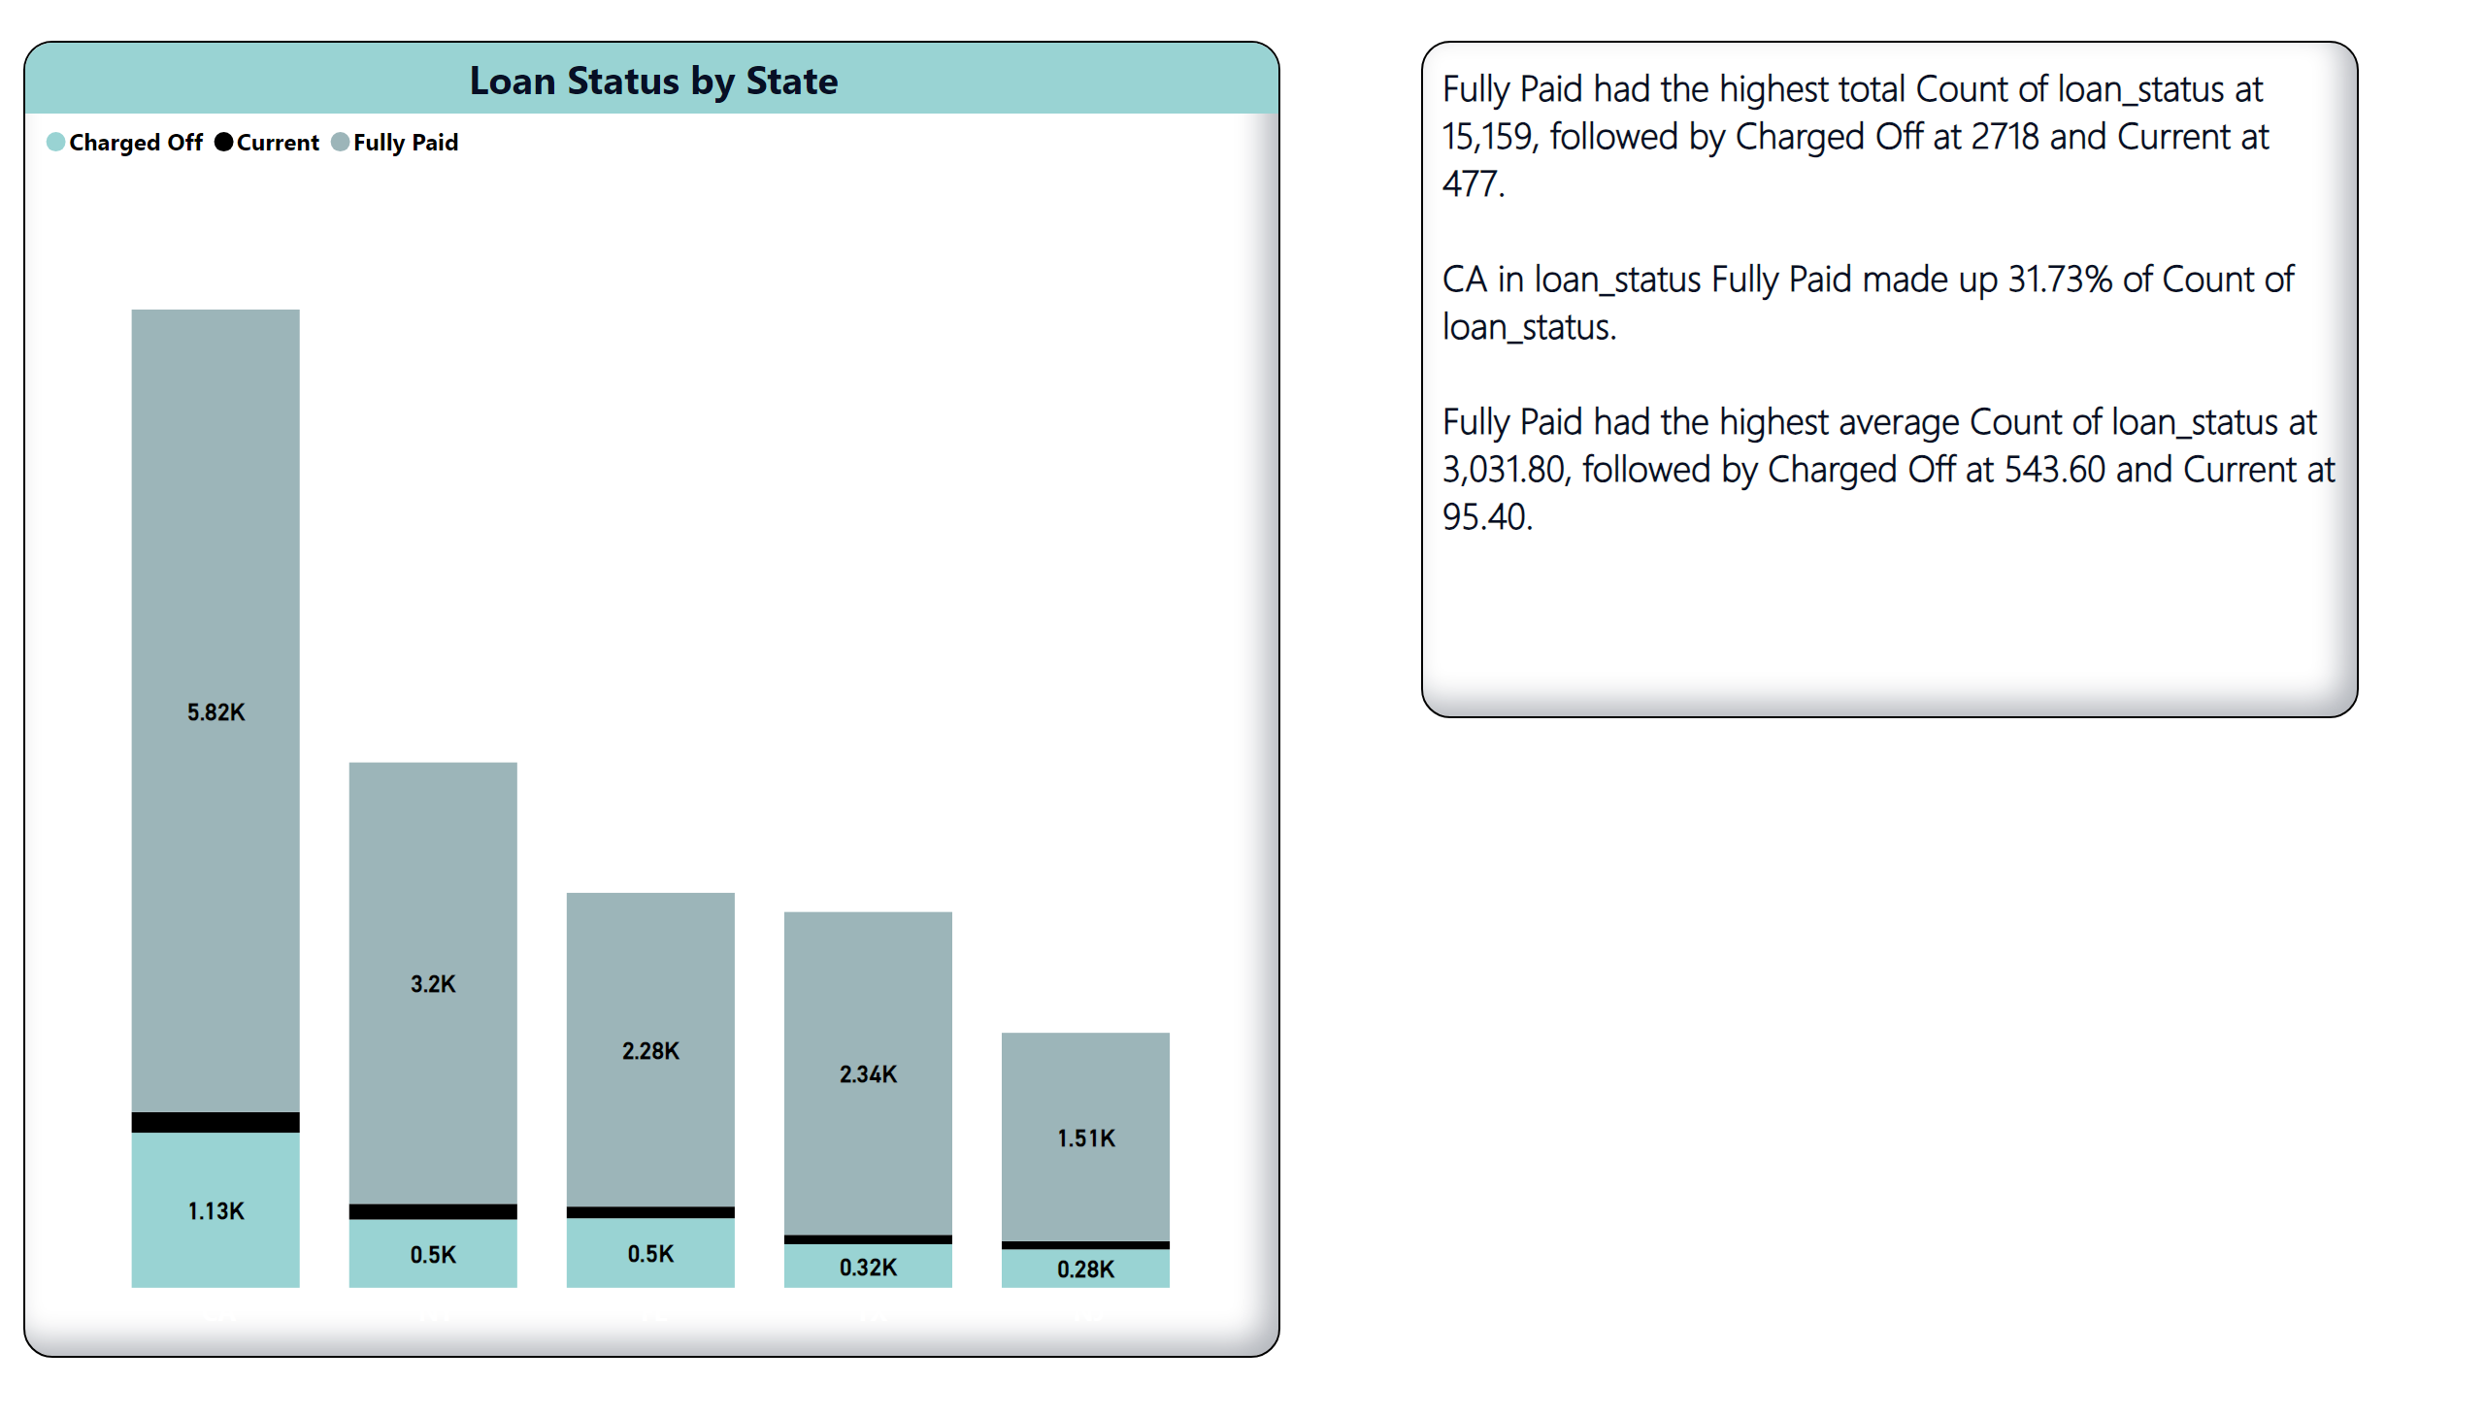
Loan Status by State
LOAN STATUS BY STATE
Unveiling Trends and Opportunities
Notes:
Loan Status by State
No alt text provided
Loan Status by State
No alt text provided

Slide 13
1. Observations:
Highest Total Count: "Fully Paid" stands out with the highest total count of Loan Status at 15,159, indicating a significant proportion of loans have been fully paid.
Regional Variation: In the state of CA, "Fully Paid" loans constitute 31.73% of the total count, suggesting a regional variation in loan statuses.
Average Counts: Despite "Fully Paid" having the highest total count, it also maintains the highest average count of Loan Status at 3,031.80, emphasizing consistent performance.
2. Suggestions:
Risk Assessment: Given the high count of "Charged Off" loans, conduct a detailed risk assessment to understand the factors contributing to charged-off loans. Identify patterns and assess the impact on overall portfolio health.
Regional Analysis: Explore reasons behind the high percentage of "Fully Paid" loans in CA. Consider tailoring marketing or lending strategies to replicate successful trends in other regions.
Retention Strategies: Given the high average count of "Fully Paid" loans, consider implementing customer retention strategies to maintain or enhance this positive trend.

Slide 14
3. Conclusions:
Performance and Stability: The dominance of "Fully Paid" loans in both total count and average count suggests a stable and successful loan portfolio with a significant portion of customers successfully repaying their loans.
Risk Management: The presence of "Charged Off" loans indicates inherent risks, highlighting the importance of robust risk management practices to minimize potential losses.
Regional Opportunities: The higher percentage of "Fully Paid" loans in CA presents an opportunity for targeted marketing or product customization to align with preferences or economic conditions in that region.
Additional Considerations:
Time Dimension: If possible, analyze the loan statuses over time to identify trends and patterns. This could provide insights into the effectiveness of recent strategies or external economic influences.
Customer Segmentation: Explore loan statuses based on customer segments to tailor strategies for different customer profiles.
Communication Strategies: Implement effective communication strategies to engage with customers in different loan statuses, encouraging positive actions and addressing concerns.

Slide 15
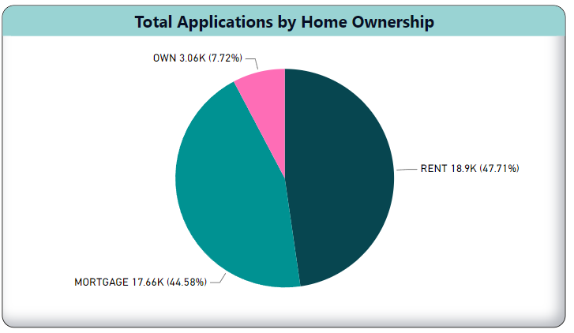
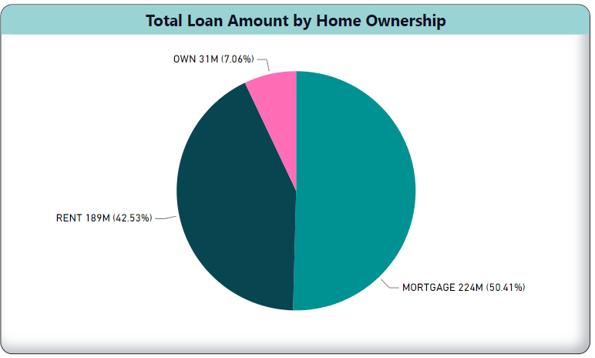
Last Payment Date
Loan Amounts and Customer Distribution Analysis
Insights into Home Ownership Categories
Notes:
multiRowCard
No alt text provided

Slide 16
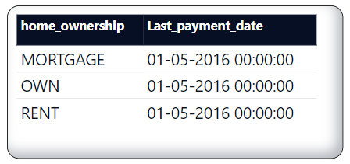
1. Observations:
Loan Amount Distribution: The distribution of loan amounts closely mirrors the customer distribution across different home ownership categories. Mortgage has the highest total loan amount (50.4%), followed by rent (42.4%), own (7%), and others (0.2%).
Customer Composition: The majority of customers who have taken loans fall into the categories of mortgage (44.3%), followed by rent (47.6%), own (7.7%), and a small percentage in the "others" category (0.2%).
Uniform Last Payment Date: Regardless of home ownership category, all customers made their last payment on 01-05-2016.

Slide 17
2. Suggestions:
Market Segmentation Analysis: Conduct a thorough market segmentation analysis to understand the factors driving loan demand in each home ownership category. Tailor marketing strategies based on these insights.
Customer Education Initiatives: Implement educational initiatives to inform customers about the advantages of different home ownership categories in the context of loan terms and conditions.
Diversification Strategies: Explore opportunities to diversify the loan portfolio by offering targeted products or incentives for customers in less dominant categories.
3. Conclusions:
Loan Amount Alignment: The alignment of loan amounts with customer distribution indicates that customers in mortgage and rent categories are significant contributors to the overall loan portfolio.
Customer Behavior Consistency: Despite differences in loan amounts, customer behavior, as reflected in the last payment date, appears consistent across all home ownership categories.
Opportunity in "Others" Category: The small percentage in the "others" category suggests an opportunity to explore and understand the needs of this niche segment, potentially tailoring offerings to attract more customers.

Slide 18
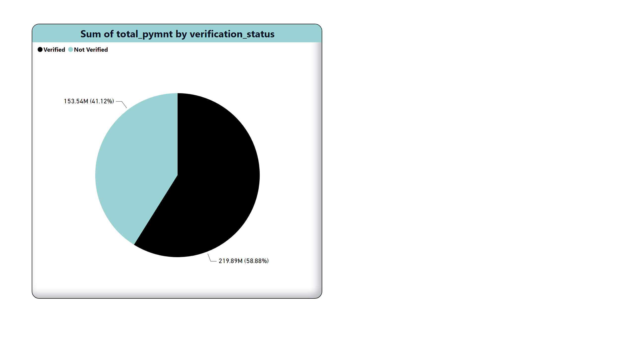
Verification Status
Verification Status vs. Total Payments
Driving Financial Commitment and Trust
Notes:
pieChart
No alt text provided

Slide 19
1. Observation: Verified Total Payments Surpass Not Verified
Key Statistic: "Verified Accounts for 58.88% of Total Payments"
Total Payment Disparity: The pie chart indicates a notable disparity in the sum of total payments between the "Verified"
and "Not Verified" verification statuses.
Verified Dominance: Verified loans account for a substantial portion of the total payments, reflecting a higher level of financial commitment from borrowers with verified status.
2. Suggestions:
Enhanced Verification Processes: Strengthen the verification processes to encourage borrowers to opt for verification, potentially increasing the overall sum of total payments.
Targeted Marketing: Develop targeted marketing strategies to educate borrowers on the benefits of verification, highlighting potentially favorable terms or incentives.
Risk Mitigation: Evaluate the impact of verification status on default rates and implement risk mitigation strategies to ensure the financial stability of the institution.

Slide 20
3. Conclusion:
Verification Status Impact: The higher sum of total payments for Verified loans suggests a positive correlation between verification status and borrower commitment to repayment.
Risk and Trust: Verified status may be associated with a higher level of trust, contributing to increased payment reliability and potentially lower default risks.
Opportunity for Growth: The dominance of Verified status in total payments presents an opportunity for targeted growth strategies, emphasizing the benefits of verification to potential borrowers.
Additional Considerations:
Customer Education: Develop educational materials or campaigns to inform borrowers about the advantages of verification, building trust and encouraging higher total payments.
Continuous Monitoring: Continuously monitor the impact of verification status on repayment behavior to adapt strategies based on evolving trends.
Competitor Analysis: Explore how competitors handle verification processes and whether there are industry best practices that can be implemented.

Slide 21
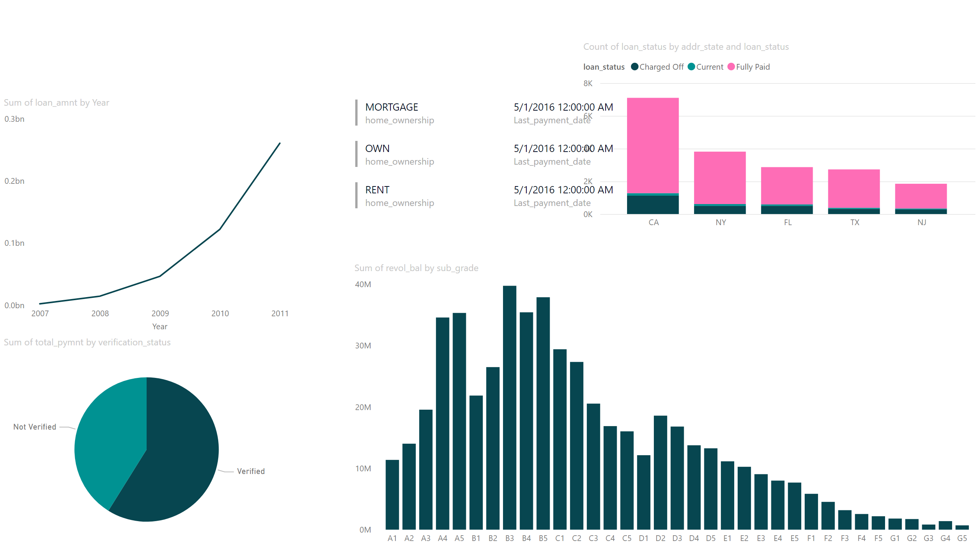
Page 1
Notes:
lineChart
No alt text provided
columnChart
No alt text provided
pieChart
No alt text provided
columnChart
No alt text provided
multiRowCard
No alt text provided

